Slide 1
Impact of temperature variations over the Bay of Bengal on the climate of Eastern coast of India

Slide 2
Introduction
Artificial intelligence (AI)
creation of human-like intelligence.
learn, reason, plan, perceive, or process natural language.
machine learning.
instructions that allow model to learn from data without step-by-step instructions by the programmer.
Data analytics
qualitative and quantitative techniques and processes
to enhance productivity and business gain.
Data is extracted and categorized to identify and analyze behavioral data and patterns.

Slide 3
Introduction
Weather - condition of air on earth at a given place and time.
The application of science and technology are to predict the state of the atmosphere in future time.
Extremely important considering its effects on human life and property.
Today, weather forecasts are made by collecting quantitative data about the current state of the atmosphere using scientific understanding of atmospheric processes to project how the atmosphere will evolve.
chaotic nature of the atmosphere implies the need of massive computational power required.

Slide 4
Problem Statement
To analyze the related weather data under data mining techniques.
To study the correlation between sea surface temperature to corresponding coastal temperature.
Implementing supervised machine learning algorithm on the available dataset.
To forecast the weather conditions.

Slide 5
Goals and objective

Slide 6
Motivation and Application

Slide 7
System design

Slide 8
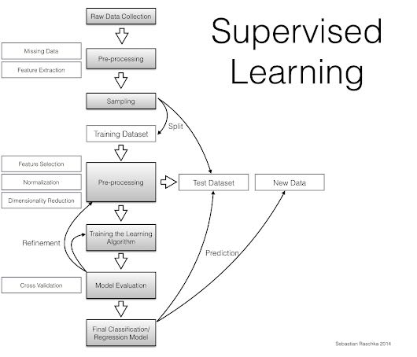
Dataflow diagram

Slide 9
implementation

